Slide 1
Asthma-related medication oversupply and carbon footprint in the Singapore General Hospital (SGH) asthma cohort
Ang Shu Wei
23 May 2024
Supervised by: Asst Prof Hong Seok Young
Notes:
Dear professors, Shu Wei here and today I will be presenting my project titled
“Asthma-related medication oversupply and carbon footprint in the Singapore General Hospital (SGH) asthma cohort”.
Asst Prof Hong is my practicum’s supervisor.

Slide 2
Outline
Review of extent of Medication Oversupply and CO₂ footprint
Medication Oversupply (definition, trends and patterns)
Total and individual Components (ICS, ICS-LABA, SABA)
Units and $$, CO₂ footprint (and compare with national CO₂ emissions)
5-year trend and annual trend
Factors associated with Medication Oversupply
Switches in inhalers (definition of inhaler switch)
Type and frequency of switch
MDI/DPI vs. change in inhaler switch (same drug but different device)
Association with Switches / ED Visits / ICU admissions/ Exacerbations
Notes:
This is the outline of the presentation. We will be reviewing the extent of medication oversupply and carbon footprint.
The definition, trends and patterns of medication oversupply. Total and individual components of ICS, ICS-LABA, and SABA.
These are types of medications commonly used for asthma treatment.
The units, medication cost and the carbon footprint as well as the 5-year trend and annual trend.
Next, we will look at the factors associated with medication oversupply. Factors that are patient-related and
Disease-related ones.
Lastly, let’s look at the switches in inhalers. The type and frequency of switch and the association with switches/ ED Visits (which is called
Emergency Department visits)/ ICU admissions and Exacerbations.

Slide 3
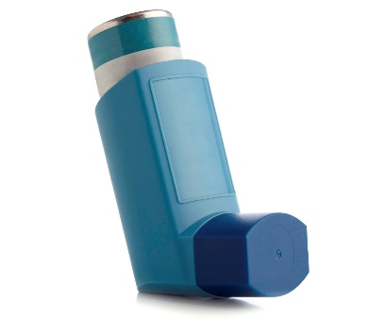
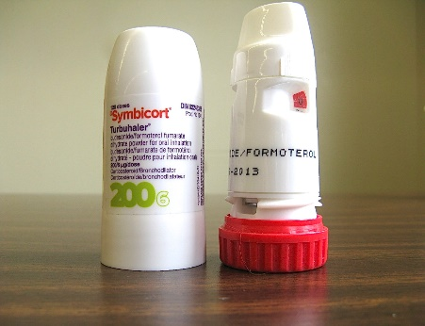
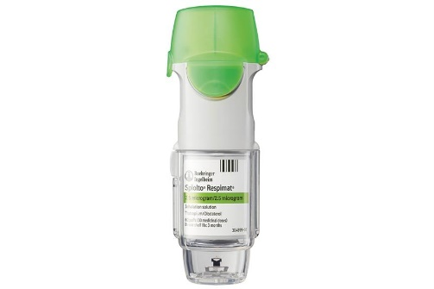
Types of inhalers and its environmental impact
Metered dose inhalers
(MDI)
Dry powder inhalers
(DPI)
Soft Mist inhaler
(SMI)
High CO₂
Low CO₂
Low CO₂
Notes:
Before we dive into this topic, it would be good to know the types of inhalers
and its environmental impact. The common types of inhalers are the Metered dose
Inhalers known as MDI, dry powder inhalers known as DPI and Soft Mist inhaler
Known as (SMI).
The reason why their carbon footprint differs is due to the type of propellant used.
The MDIs used hydrofluorocarbons called HFCs as a propellant.
Although HFCs are not ozone-depleting substances, they are still greenhouse gases that have a
high global warming potential. Thus, contributing the most carbon footprint to the
environment.

Slide 4



Types of inhalers and how it works
MDI
DPI
SMI
Puffs dose of medicine when you press on it
Delivers powder when you inhale
Sprays dose of medicine when you press on it
Notes:
The choice of inhaler depends on patient's preference. Some
may want to puff dose of medicine instead of inhaling it by choosing MDI over DPI.

Slide 5
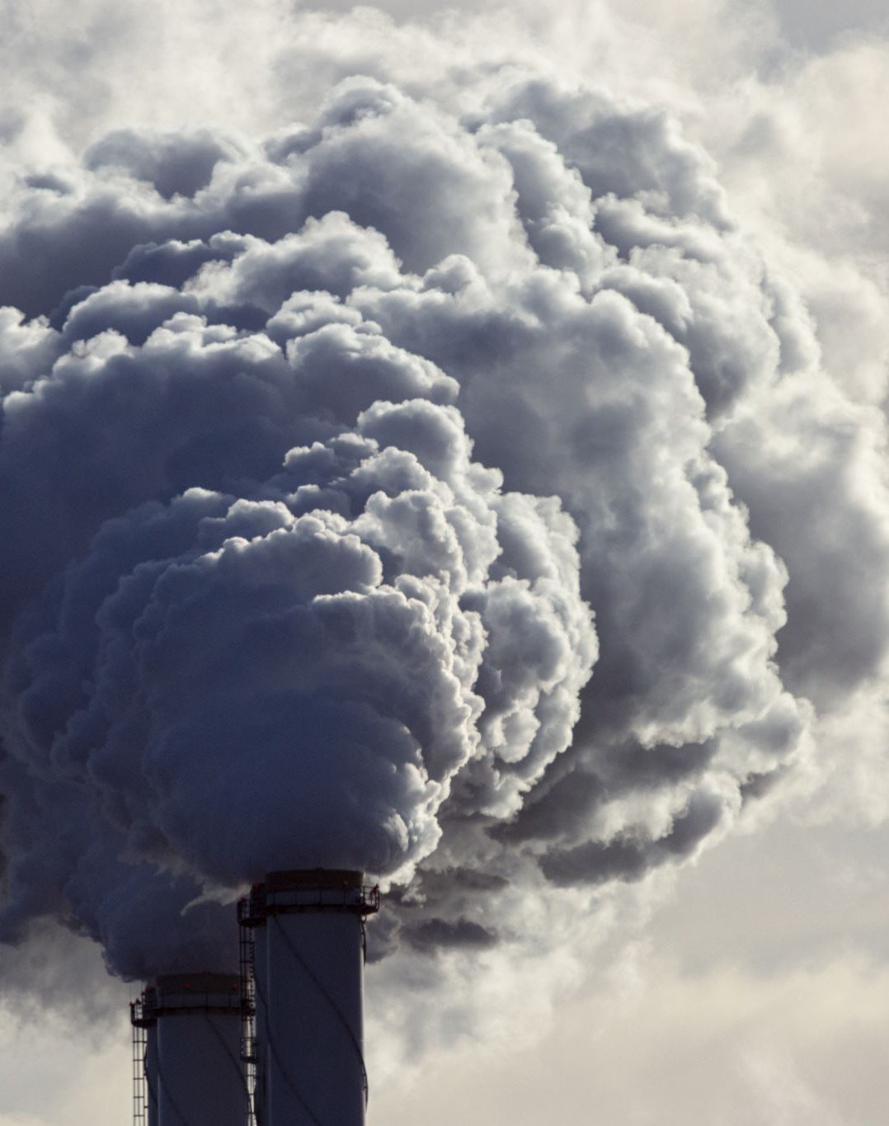
Background – Reducing CO₂ emissions
Asthma inhalers especially MDIs produced much significant CO₂ as compared to those of DPIs
CO₂ is one of the most significant greenhouse gases which contributes to global warming issues
Erratic weather, hotter weathers can be seen on the news “2023 was Singapore’s 4th hottest year on record”¹
High heat stress puts people at greater risk of heat exhaustion and heat strokes²
¹https://www.straitstimes.com/singapore/environment/2023-was-singapore-s-4th-hottest-year-on-record-tying-with-1997-and-2015
²https://www.straitstimes.com/singapore/singapore-in-2100-no-escape-from-scorching-heat-dry-spells-and-rising-seas
Notes:
Why do we want to reduce carbon emissions specifically CO2 emissions?
Asthma inhalers especially MDIs as mentioned earlier produced much significant CO2
as compared to DPIs. This causes global warming issues like erratic weather, hotter weathers.
And high heat stress puts people at greater risk of heat exhaustion and heat strokes.

Slide 6

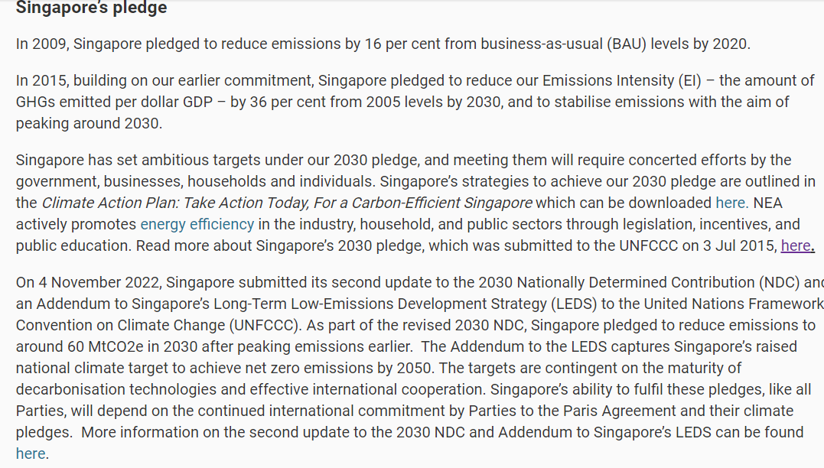
Notes:
Despite Singapore being a relatively small country, our government is committed to
Fight climate change and has pledged to reduce carbon emissions by 16% from Business As Usual levels
by 2020 and aims to reduce 60 million tonnes of CO2 by 2030.
Our study is significant as this can potentially influence government policies on the
use of inhalers especially in public hospitals like SGH.

Slide 7


What other countries have done
What other countries have adopted
Most common unit of measurement for carbon footprint is CO₂
Ways to reduce carbon footprint:
Switch inhalers to lower carbon alternatives (i.e., from MDIs to DPIs)¹
Programmes of educating the storage of asthma inhalers²
Reducing medication oversupply
Reasons for medication oversupply:
Over-purchasing, non-adherence to treatment, and saving medicines for future use
Pharmacist-delivered counselling³ on patients' knowledge and beliefs about the medicines, adherence level, and asthma control.
¹Liang, et al (2023). BCMJ, 65(4), 122-127.
²Jafarzadeh, et al (2021). BMC Public Health, 21(1), 1127
³Kovačević, et al. (2018). Research in Social and Administrative Pharmacy, 14(6), 603-611.
Notes:
Let’s look at what other countries have done!
The most common unit of measurement for carbon footprint is CO₂.
We can explore ways to reduce CO2 by switching inhalers to lower carbon alternatives
and having programmes to educate the patients on the storage of inhalers as
proper storage can lengthen the lifespan of inhalers.
Some reasons for medication oversupply include over purchasing,
non-adherence and trying to save medicine for future use.
Pharmacist-delivered counselling on patients’ knowledge and beliefs about medicines,
Adherence level and asthma control can help to reduce medication oversupply due to overuse.
While there has been a lot of qualitative research on how inhalers will impact
the environment as discussed, there has not been much quantitative research on this topic

Slide 8

Study objectives
Understand the extent of carbon footprint in SGH asthma cohort
Contribution by individual inhalers
Temporal trends (2015-2019) of the carbon footprint from the inhalers
Understand the extent of medication oversupply
Factors associated with medication oversupply
Notes:
Therefore, these are our study objectives as mentioned in the outline earlier.
To understand the extent of carbon footprint in SGH asthma cohort, we look
at the contribution by individual inhalers and the temporal trends of the
Carbon footprint for the 5 years from the inhalers
Next to understand the extent of medication oversupply we look at the factors
associated with medication oversupply.

Slide 9
Methodology
Defining terminologies
Carbon footprint:
CO₂/kg of 1 canister/bottle of inhaler
Medication oversupply²:
MPR (of ICS-containing inhaler) > 1.2
SABA over dispensation³:
3 >= SABA canisters in a year
Carbon footprint and cost of inhalers match with the visits data and cohort data
Retrospective analysis of asthmatic patients’ records from SingHealth COPD and Asthma Data Mart (SCDM)¹
Temporal trends of carbon footprint of inhalers
Factors contributing to medication oversupply via multivariate logistic regression
Association and correlation of the switch in inhalers
¹ Lam et al. (2023). BMC Medical Informatics and Decision Making, 23(1), 4. DOI: 10.1186/s12911-022-02071-6
² Williams LK et al. Journal of Allergy and Clinical Immunology 2011;128:1185-1191.e2.
³ Nwaru BI et al. European Respiratory Journal 2020;55.
Notes:
Let’s look at the methodology
First, we came up with the carbon footprint and cost of inhalers so that we can
Match each inhaler to its carbon footprint and cost correctly.
And perform cleaning by aligning the medication names before matching.
Once done, we match the information to all the inhalers in the visits data whereby you can find all the visits for 1 patient.
While the cohort data mean that we have already grouped by each patient to find for example total
Inhalers used by the patient throughout the 5 years etc.
Next, we performed a retrospective analysis of a multi-ethnic cohort of asthmatic patients
seen in SGH from 2015 to 2019. Patient records were retrieved from the Singhealth COPD
and Asthma Data Mart. To look at the temporal trends of the carbon footprint of the inhalers.
After which we perform the multivariate logistic regression on the cohort data to find the factors
contributing to medication oversupply.
The bonus would be to see the association and correlation of the switch in inhalers with total no. of Switches / ED Visits /
ICU admissions and Exacerbations.
Let’s look at how we define key words:
Carbon footprint is CO2 per kg of 1 canister or bottle of inhaler.
“MPR" refers to the Medication Possession Ratio, a common metric used to measure medication adherence.
Simply put, an MPR greater than 1 indicates that more medication is dispensed than needed for the days in the period.
ICS is used specifically to define MPR because ICS is the backbone of the asthma therapy.
We coined medication oversupply if patients have MPR > 1.2.
SABA overdispensation is when a patient has 3 or more SABA canisters in a year.

Slide 10
CO₂ footprint for each inhaler
Bo up
¹ Gagné, M., Karanikas, A., Green, S., & Gupta, S. (2023). Reductions in inhaler greenhouse gas emissions by addressing care gaps in asthma and chronic obstructive pulmonary disease: an analysis. BMJ Open Respiratory Research, 10(1), e001716. https://doi.org/10.1136/bmjresp-2023-001716
Notes:
This is the carbon footprint of each inhaler after verifying
through various sources like looking at the strength,
brand and components of the inhaler. We try
to match the correct carbon footprint of each inhaler.
And the cost of each inhaler is provided by SGH pharmacists
whom I collaborated with in the study.
From the carbon footprint, MDIs have high carbon footprint as compared to DPIs and SMIs.

Slide 11
5-year Distribution of carbon footprint (contribution by various inhaler types)
(kg)
Notes:
Throughout the 5 years, the total carbon footprint is the highest for
ICS-LABA MDI followed by SABA then ICS MDI.
Comparing All MPR and MPR>1.2 (Medication Oversupply group),
the average carbon footprint per patient over the 5 years is higher for the
medication oversupply group. Especially for the ICS-LABA MDI, it is around 30% higher.

Slide 12

Temporal trend of carbon footprint (contributed by various inhalers)
 | Total CO₂ footprint kg
 | ICS MDI | ICS DPI | ICS-LABA MDI | ICS-LABA DPI | SABA
2015 | 68,143 | 740 | 114,476 | 3,377 | 59,875
2016 | 68,641 | 705 | 151,229 | 4,630 | 65,314
2017 | 68,406 | 634 | 172,433 | 5,278 | 69,934
2018 | 66,333 | 603 | 193,389 | 5,591 | 69,775
2019 | 64,623 | 503 | 214,575 | 6,453 | 66,931
2015-2019 | 335,146 | 3,185 | 846,102 | 25,329 | 331,829
Notes:
Looking at the temporal trend of carbon footprint,
ICS-LABA is increasing across the years.
This is just the tip of the iceberg. Because if you see in
terms of the no. of unique patients having the medication.
SABA has the highest no. of patients using it.

Slide 13
Temporal trend of inhaler dispensed increasing MDI (mostly ICS-LABA) use over the years
SABA is the most commonly dispensed inhaler.
ICS-LABA use is increasing over the 5-year period
Notes:
From the chart, …

Slide 14
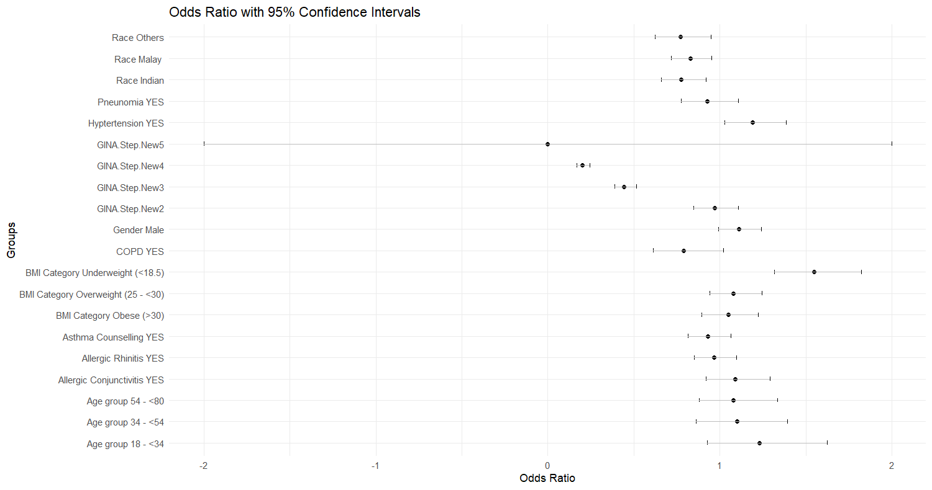
Understanding medication oversupply
MPR <=1.2 reference group;
MPR > 1.2
*
*
*
*
*
*
*
* p-value <0.01
Notes:
This is the multivariate logistic regression analysis result
on the patient-related and disease-related factors with the reference group ‘MPR <= 1.2’.
Patient related factors are race, gender, BMI groups, and age groups.
The rest are disease-related factors such as Pneumonia and Hypertension, and GINAstep etc.
We found out that Chinese is more likely to be associated with oversupply.
And patients with GINAstep 1 is more likely to have Oversupply. In GINA step 1, patients typically
do not use ICS/ ICS-LABA since it is considered the lowest severity of asthma treatment required.
Thus leading them to rely more on SABAs and this causes overuse of medication instead.
FYI: Increasing severity of asthma GINAstep 1 (lowest severity); GINAstep5 (highest severity)
GINAsthma (GINA Step) refers to the stepwise approach to asthma management
recommended by the Global Initiative for Asthma (GINA). This approach helps
healthcare providers tailor treatment plans based on the severity and control
of a patient's asthma. The goal is to achieve and maintain control of symptoms,
minimize the risk of exacerbations, and improve overall quality of life.

Slide 15
Switch of inhalers
Inhaler switch (different drug, different device) Inhaler switch (same drug, different device) No inhaler switch
Total no of switches | [0,1] | (1,3] | (3,5] | (5,Inf]
Inhaler switch (different drug, different device) | 455 | 335 | 69 | 11
Inhaler switch (same drug, different device) | 58 | 80 | 15 | 7
No inhaler switch | 6454 | 485 | 44 | 10
Total no. of ED Visits | [0,4] | (4,9] | (9,14] | (14,Inf]
Inhaler switch (different drug, different device) | 761 | 70 | 22 | 17
Inhaler switch (same drug, different device) | 144 | 7 | 5 | 4
No inhaler switch | 6573 | 292 | 66 | 62
Exacerbation Category | 0 exacerbation | 1 exacerbation | 2 exacerbations | > 2 exacerbations
Inhaler switch (different drug, different device) | 177 | 24 | 21 | 648
Inhaler switch (same drug, different device) | 25 | 2 | 0 | 133
No inhaler switch | 2734 | 217 | 147 | 3895
Total no. of ICU admissions | 0 admissions | 1 admission | 2 admissions | 3 admissions
Inhaler switch (different drug, different device) | 856 | 12 | 2 | 0
Inhaler switch (same drug, different device) | 155 | 4 | 1 | 0
No inhaler switch | 6938 | 52 | 2 | 1
Notes:
For the switch of inhalers, we look at the cohort data and calculated the total no. of
Switches / ED Visits / ICU admissions/ Exacerbations of each patient.
We have sliced the cohort data into 3 groups.
For no inhaler switch, it means patients with no change in inhaler at all.
For inhaler switch, it is broken down to either different drug different device or
same drug different device. Same drug meaning that the medication used is the same
to cure asthma. Different device meaning it can be from MDI to DPI. For example
Symbicort MDI to Symbicort DPI is an example of same drug different device.
What is interesting to see here is to explore those patients with frequent exacerbations and ED visits but did not switch inhaler.

Slide 16
Correlation between the groups of patients associated with:
ED Visits vs ICU admissions
Switches vs Exacerbations
Notes:
There is an increasing correlation if we look at the 3 groups - when we look at the
correlation between the ED Visits and ICU admissions and the correlation
between Switches and Exacerbations.
This shows that those with inhaler switch (same drug, different device)
is more associated with ED Visits and ICU admissions. This could be that
the device is not suitable for the patient despite having correct medication.

Slide 17
Conclusion
ICS-LABA MDI has the greatest contribution to carbon footprint.
Over the years, SABA use did not decline (despite guideline recommendations) and ICS-LABA MDI use increased (possibly due to guideline recommendations for earlier ICS-LABA use).
Average carbon footprint for ICS-LABA DPI is the lowest. However, they are one of the most expensive inhalers.
It might pose challenges for Singapore hospitals to encourage patients to switch from ICS-LABA MDIs to ICS-LABA DPIs due to the higher cost of switching.
Another viable option is to switch from branded to generic forms (symbicort to duoresp).
Explore those patients with frequent exacerbations / ED visits but did not switch inhaler.
Notes:
Read from slide.
Symbicort Rapihaler to DuoResp (100X carbon footprint) 32 vs 0.34
(go back to the carbon footprint slide 10) can show this point

Slide 18

Reflections
In the beginning, it looks daunting to be able to achieve the objectives as the time is short.
Challenges:
Steep learning curve
Time management
Opportunities:
To be able to collaborate with multidisciplinary team (data management team, pharmacists, clinicians) and be part of a meaningful project
Overall, this is a great experience!
Notes:
My reflections for the project.
Read from slide.
As this topic of asthma and its inhalers is relatively new to me,
it is a steep learning curve for me to understand this project
before embarking on it. Besides self-learning on asthma inhalers
through online materials, I am grateful to be given the opportunity
to connect with pharmacists who were able to give me a crash course
on asthma inhalers which speeds up my understanding.
To juggle between my full-time job and the tasks set out to do for the project is challenging.
The dataset only resides in a few computers due to strict access to patients’ data which only can
be accessed during working hours. As such, I can only work on the dataset during working hours in between of my current working time.
Opportunities like collaboration with multidisciplinary team is priceless and be part of a meaningful project.
We are preparing for manuscript submission and poster submission for various conferences.
Have already submitted 1 abstract to a conference.
Overall, this is a great experience.

Slide 19
Acknowledgement
Asst Prof Hong Seok Young
Prof Sean Lam and Dr Mariko Koh
Dr Toh Ming Ren, Gerald Xuan and Ishita Goel
Low Kai Xin and Vivian Tan
Colleagues at Health Services Research at SingHealth HQ
Notes:
I would to express my gratitude to everyone who has contributed
and helped me in this project.
Asst Prof Hong who has diligently guiding me and
give me various pointers to improve my report as well as my presentation.

Slide 20

Notes:
Thank you!

